Slide 1
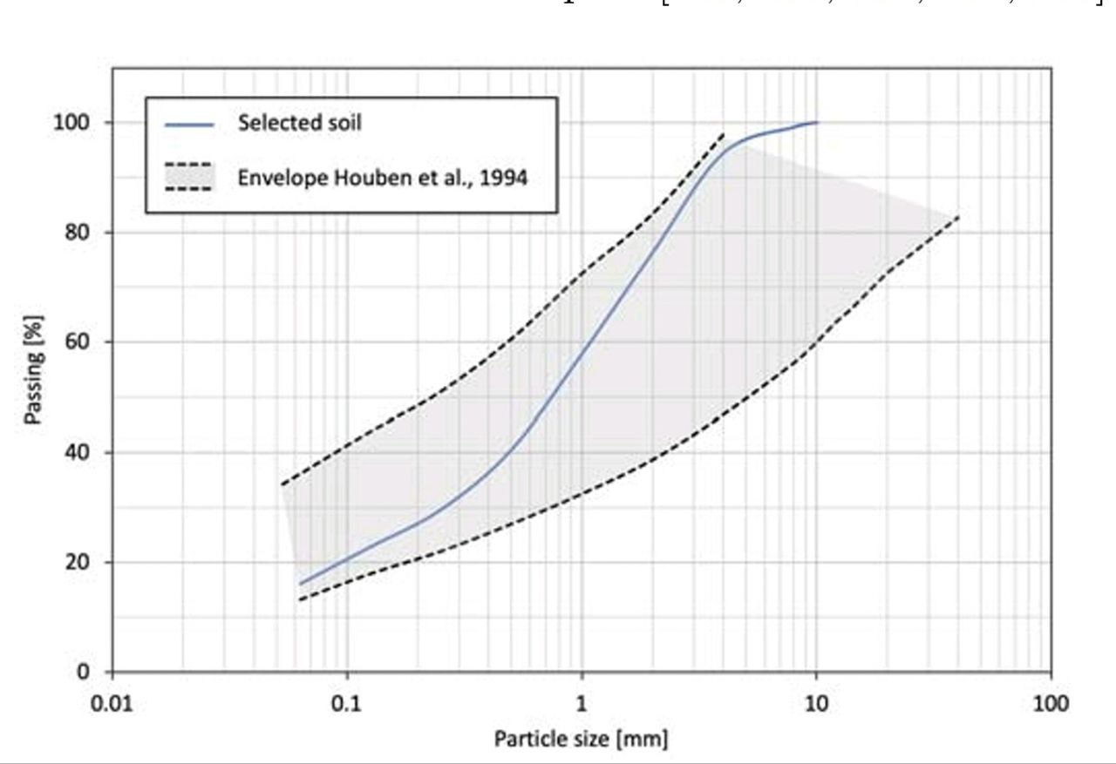
THIS IS THE FORMAT FOR THE TITLE
First author surname, name (1); Second author surname, name (2); Third autor surname, name (3).
(1) Affiliation: ;(2) Affiliation: ; (3) Affiliation: .
I. SECTION NAME
This the format that must be used for any text included in the poster presentation (Bahnschrift, 24). 1 cm must be left blank for both sides.

Slide 2
THIS IS THE FORMAT FOR THE TITLE
First author surname, name (1); Second author surname, name (2); Third autor surname, name (3).
(1) Affiliation: ;(2) Affiliation: ; (3) Affiliation: .
I. SECTION NAME
This the format that must be used for any text included in the poster presentation (Bahnschrift, 24). 1 cm must be left blank for both sides.

